Slide 1
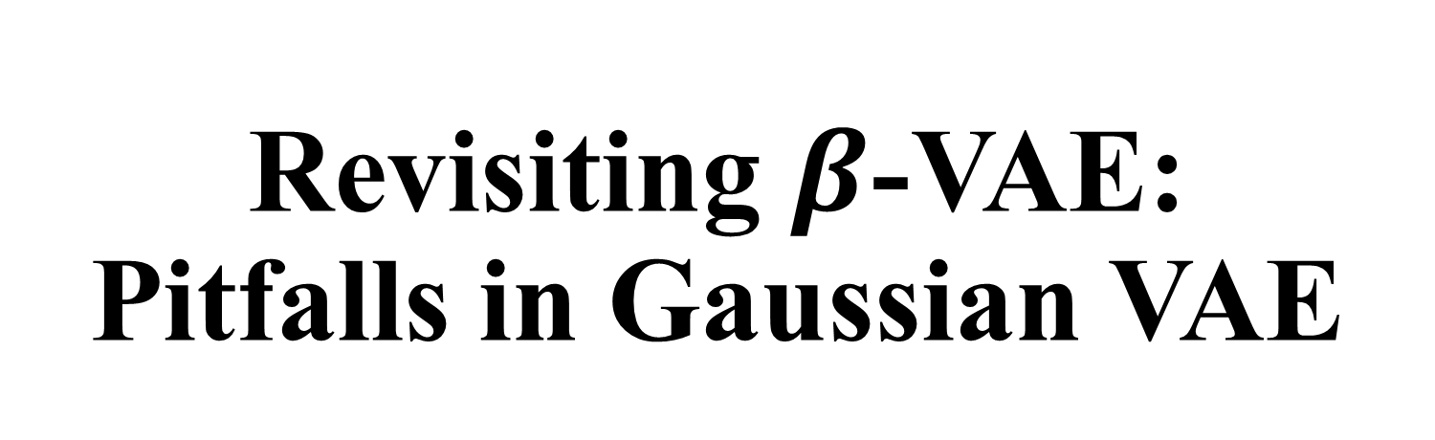
Revisiting $β$-VAE: Pitfalls in Gaussian VAE
Presenter: Kim Seung Hwan (overnap@khu.ac.kr)

Slide 2
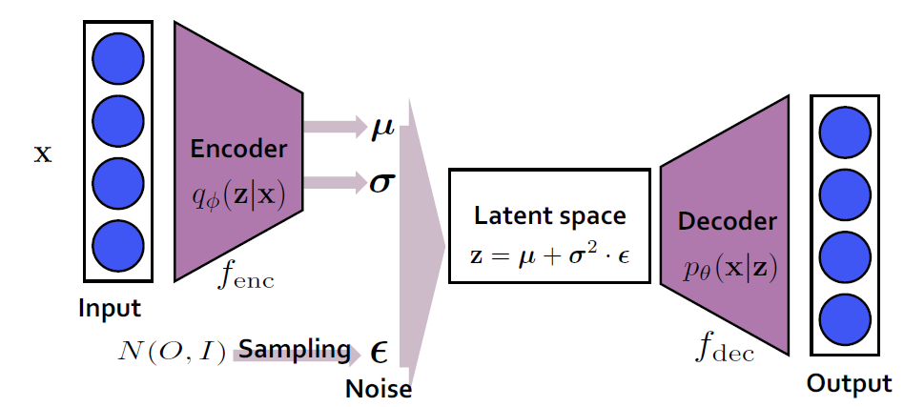

Variational Autoencoder
VAE is a Latent Variable Model
Statistically speaking, it infers latent $Z$ from observable $X$
$X$ will be a dataset in the ML or DL field

Slide 3
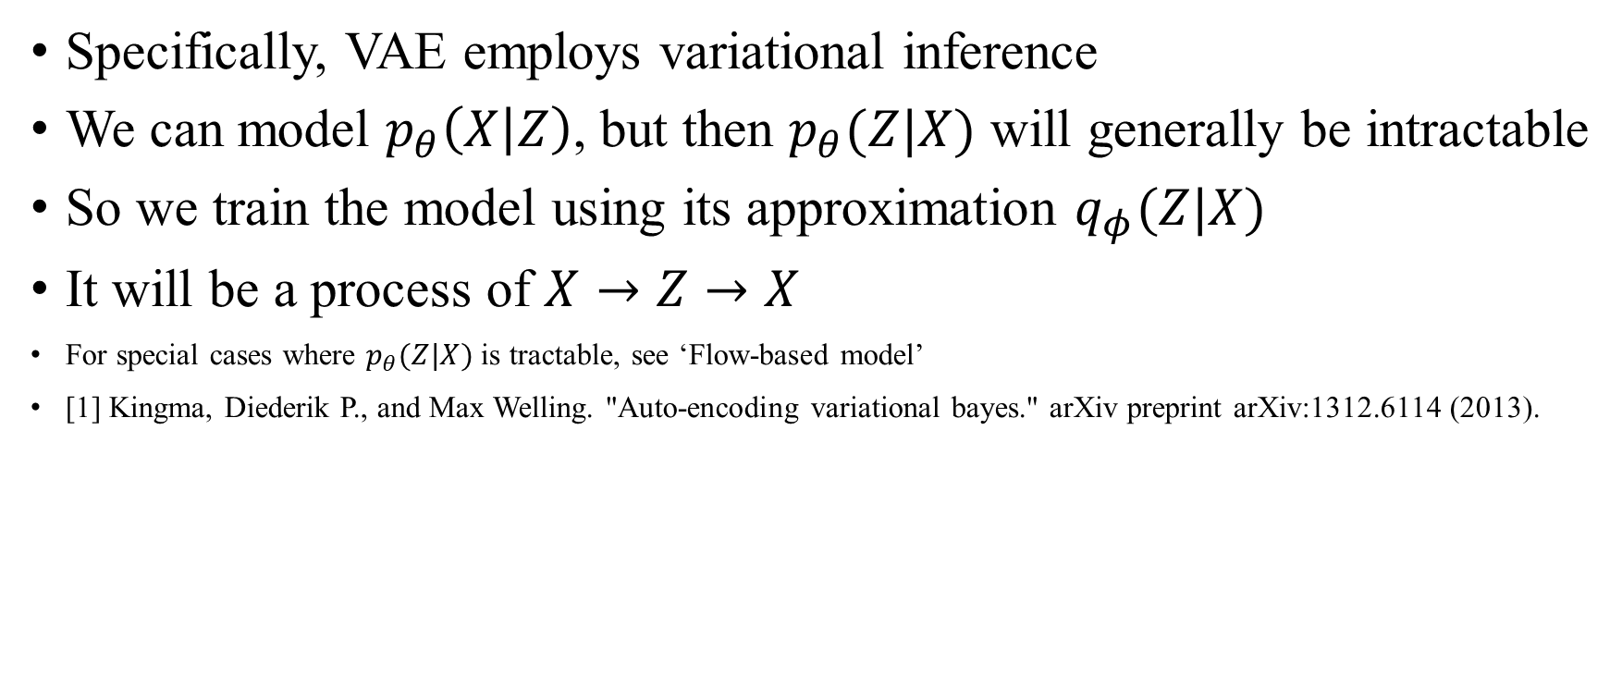
Variational Autoencoder (contd.)
Specifically, VAE employs variational inference
We can model $p_{θ}\left(X | Z\right)$, but then $p_{θ}(Z|X)$ will generally be intractable
So we train the model using its approximation $q_{φ}(Z|X)$
It will be a process of $X→Z→X$
For special cases where $p_{θ}(Z|X)$ is tractable, see ‘Flow-based model’
[1] Kingma, Diederik P., and Max Welling. "Auto-encoding variational bayes." arXiv preprint arXiv:1312.6114 (2013).

Slide 4

Variational Autoencoder (contd.)
It learns the lower bound of the likelihood function as the objective
$p_{θ}\left(X\right)≥E_{z\sim q_{φ}\left(Z | X\right)}\left[\log{p_{θ}\left(X | Z\right)}\right]−D_{KL}(q_{φ}(Z|X)||p\left(Z\right))$ (ELBO)
Red one is the reconstruction loss, the other is the regularization loss
This equation is completely tractable with a few assumption

Slide 5
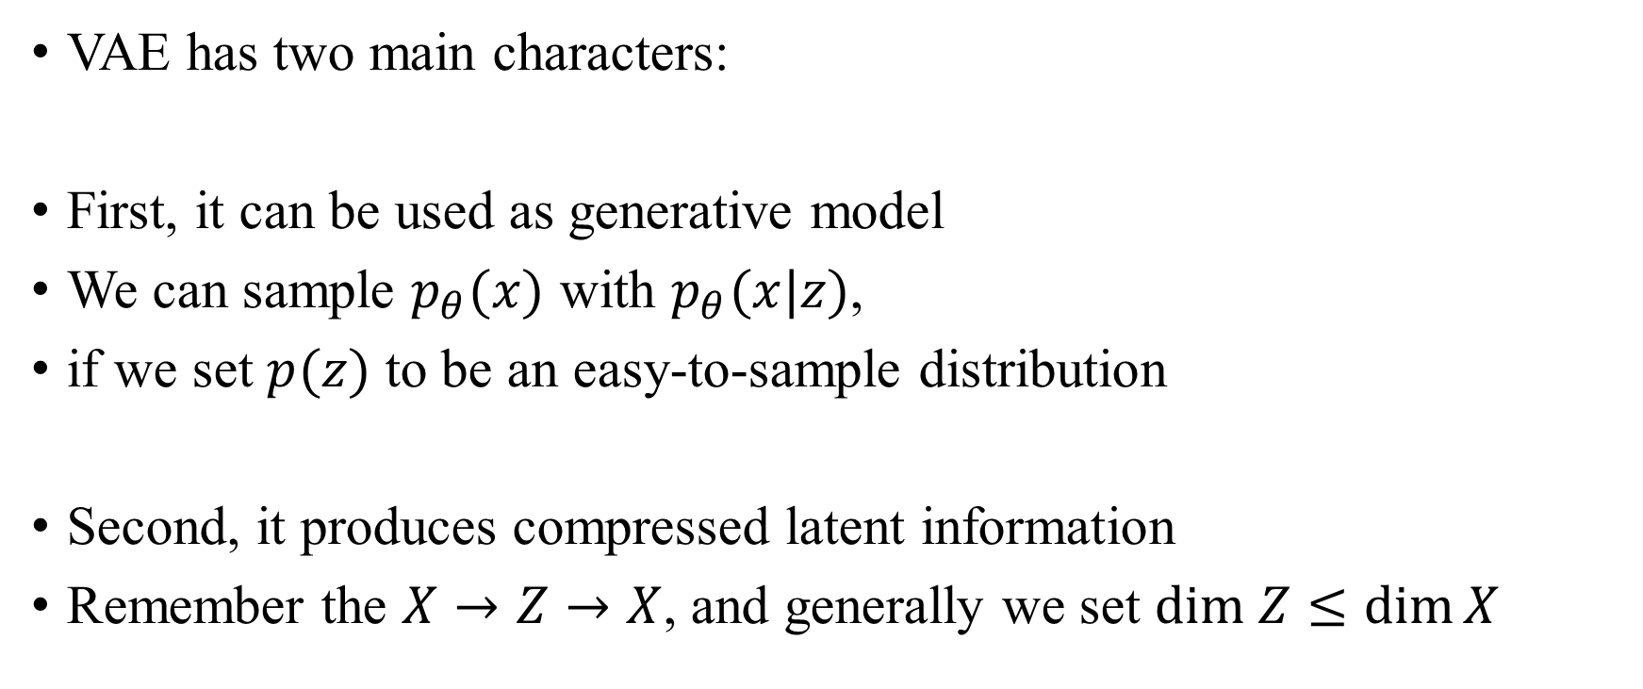
Where VAE can be used
VAE has two main characters:
First, it can be used as generative model
We can sample $p_{θ}(x)$ with $p_{θ}(x|z)$,
if we set $p(z)$ to be an easy-to-sample distribution
Second, it produces compressed latent information
Remember the $X→Z→X$, and generally we set $dim Z≤\dim{X}$

Slide 6
Where VAE can be used (contd.)
Therefore, VAE can be used to obtain good samples
Or to obtain lower-dimension representation
e.g. Sentence generation[2], Image compressing[3], Outlier detection[4], …
Molecular generation[5], Unsupervised learning (to get representation), etc.
[2] Bowman, Samuel R., et al. "Generating sentences from a continuous space." arXiv preprint arXiv:1511.06349 (2015).
[3] Ballé, Johannes, et al. "Variational image compression with a scale hyperprior." arXiv preprint arXiv:1802.01436 (2018).
[4] An, Jinwon, and Sungzoon Cho. "Variational autoencoder based anomaly detection using reconstruction probability." Special lecture on IE 2.1 (2015): 1-18.
[5] Jin, Wengong, Regina Barzilay, and Tommi Jaakkola. "Junction tree variational autoencoder for molecular graph generation." International conference on machine learning. PMLR, 2018.
These papers are highly cited examples, so read on if you are interested!

Slide 7
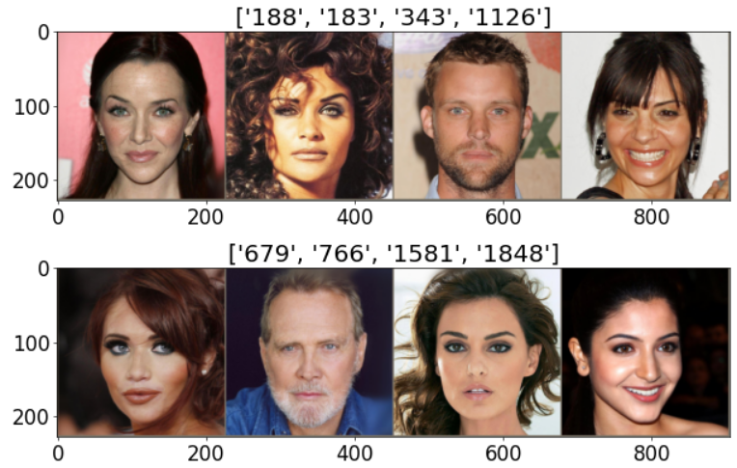
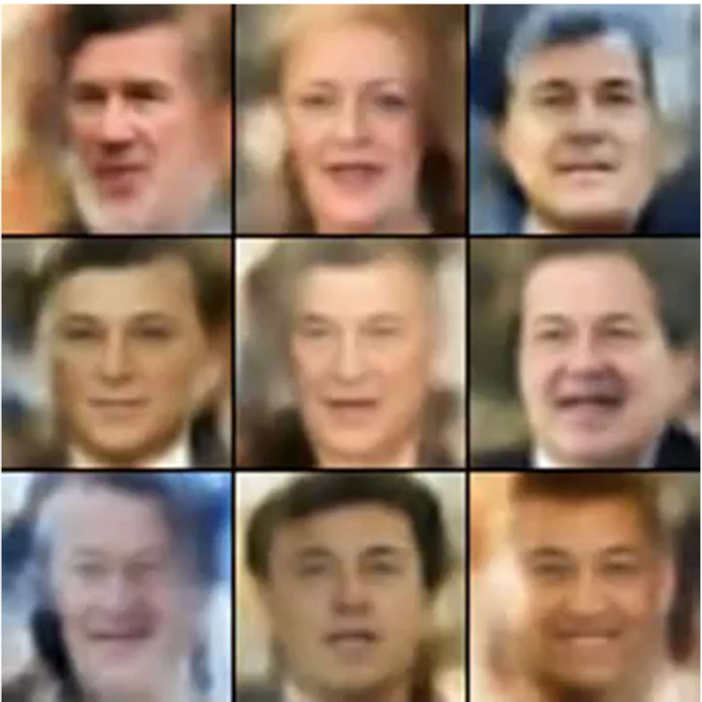
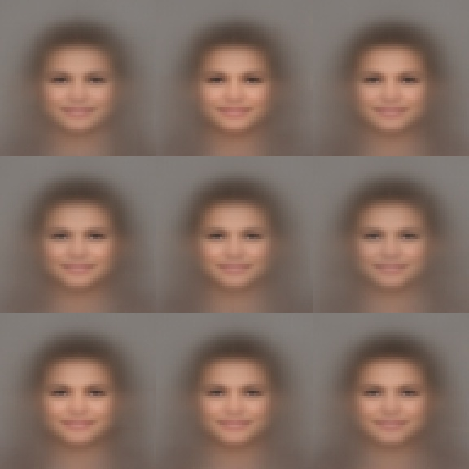
Pros and Cons of VAE
Pros
Solid mathematical background
Lightweight; simple structure and implementation (compared to the Diffusion)
No need adversarial strategy (compared to the GAN)
Low-dimensional latent variable
Cons
Posterior collapse (autodecoding-like behavior – always outputting the same)
Blurry output (bad reconstruction)
Poor sampling quality (samples from prior are noticeably worse than reconstruction)

Slide 8
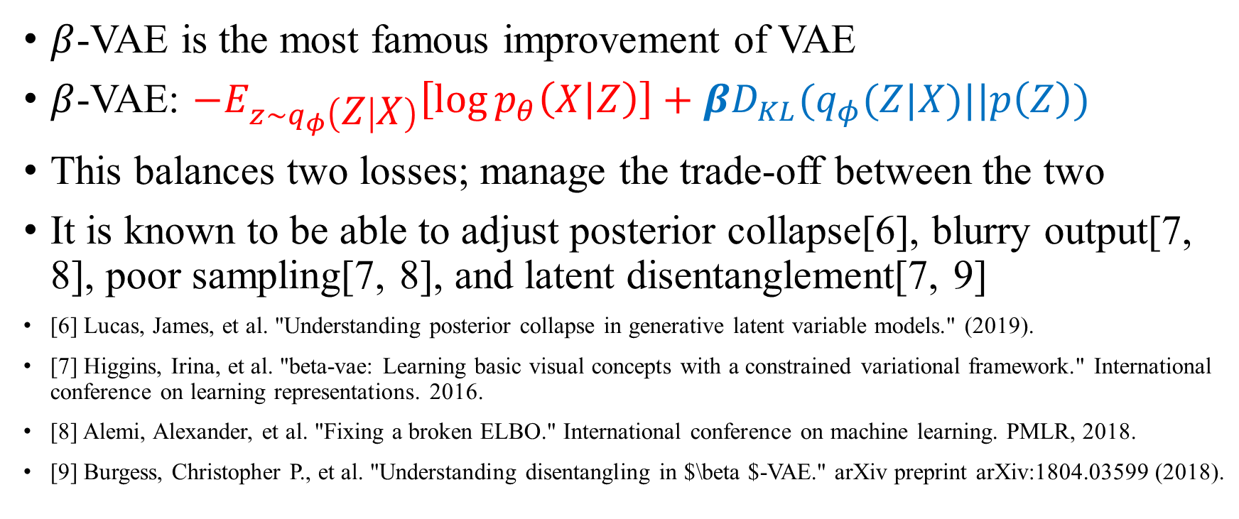
beta-VAE
$β$-VAE is the most famous improvement of VAE
$β$-VAE: $−E_{z\sim q_{φ}\left(Z | X\right)}\left[\log{p_{θ}\left(X | Z\right)}\right]+βD_{KL}(q_{φ}(Z|X)||p\left(Z\right))$
This balances two losses; manage the trade-off between the two
It is known to be able to adjust posterior collapse[6], blurry output[7, 8], poor sampling[7, 8], and latent disentanglement[7, 9]
[6] Lucas, James, et al. "Understanding posterior collapse in generative latent variable models." (2019).
[7] Higgins, Irina, et al. "beta-vae: Learning basic visual concepts with a constrained variational framework." International conference on learning representations. 2016.
[8] Alemi, Alexander, et al. "Fixing a broken ELBO." International conference on machine learning. PMLR, 2018.
[9] Burgess, Christopher P., et al. "Understanding disentangling in $\beta $-VAE." arXiv preprint arXiv:1804.03599 (2018).

Slide 9
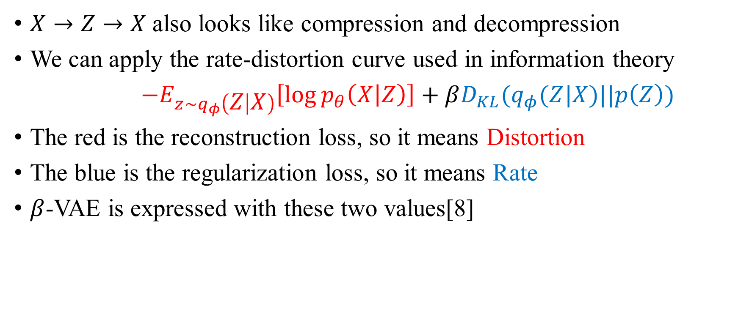
Rate-Distortion Curve
$X→Z→X$also looks like compression and decompression
We can apply the rate-distortion curve used in information theory
$−E_{z\sim q_{φ}\left(Z | X\right)}\left[\log{p_{θ}\left(X | Z\right)}\right]+βD_{KL}(q_{φ}(Z|X)||p\left(Z\right))$
The red is the reconstruction loss, so it means Distortion
The blue is the regularization loss, so it means Rate
$β$-VAE is expressed with these two values[8]

Slide 10
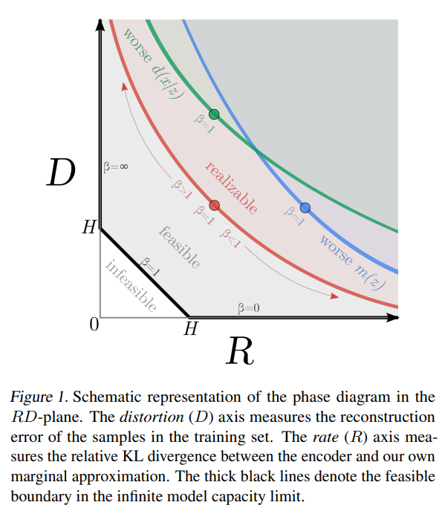


Rate-Distortion Curve (contd.)
So the $β$-VAE is a point on the valid RD curve
And the $β$ is the parameter that causes it to move along it

Slide 11
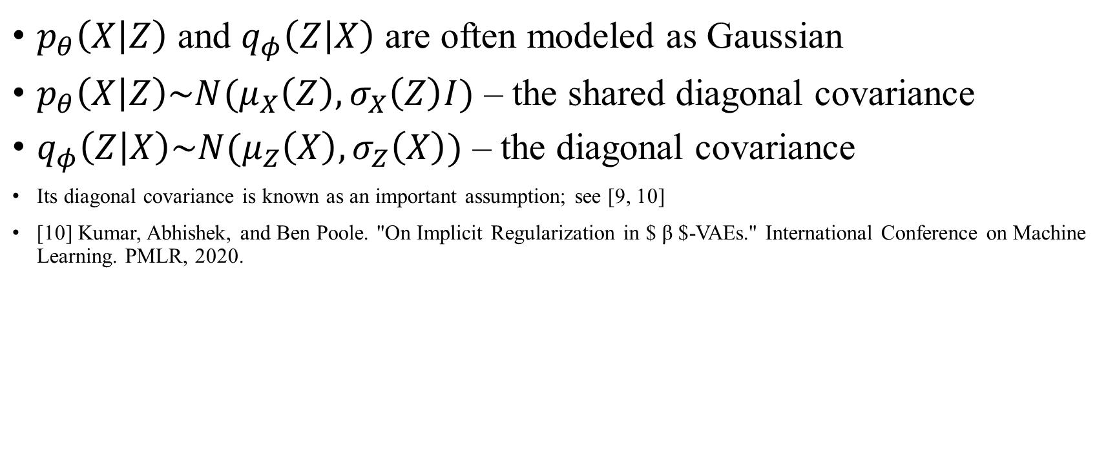
Implementation of VAE
$p_{θ}\left(X | Z\right)$ and $q_{φ}\left(Z | X\right)$ are often modeled as Gaussian
$p_{θ}\left(X | Z\right)\sim N(μ_{X}\left(Z\right), σ_{X}\left(Z\right)I)$ – the shared diagonal covariance
$q_{φ}\left(Z | X\right)\sim N(μ_{Z}\left(X\right), σ_{Z}\left(X\right))$ – the diagonal covariance
Its diagonal covariance is known as an important assumption; see [9, 10]
[10] Kumar, Abhishek, and Ben Poole. "On Implicit Regularization in $ β $-VAEs." International Conference on Machine Learning. PMLR, 2020.

Slide 12
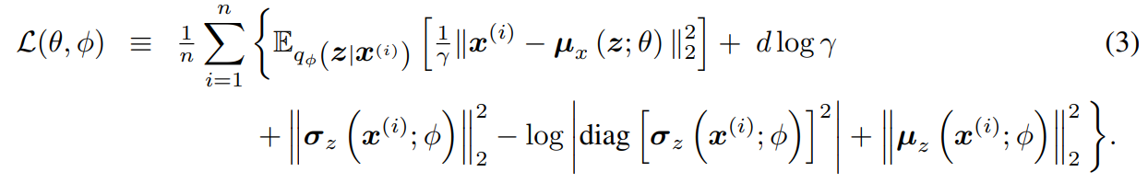

Implementation of VAE (contd.)
$σ_{X}\left(Z\right)$ is usually set to be a constant
Perhaps because learning $σ_{X}\left(Z\right)$ introduces instability
$σ_{X}\left(Z\right)$ sometimes goes to 0 and this makes an infinite gradient
Greens can be infinitely large or small
Reconstruction loss (Distortion)
Regularization loss (Rate)

Slide 13
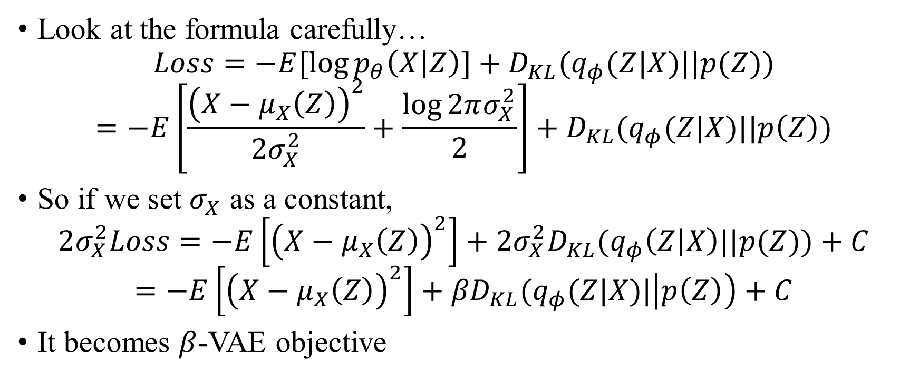
Connection between sigma and beta
Look at the formula carefully…
$$Loss=−E[\log{p_{θ}\left(X | Z\right)}]+D_{KL}(q_{φ}(Z|X)||p(Z))$$
$$=−E\left[\frac{{\left(X−μ_{X}\left(Z\right)\right)}^{2}}{{2σ}_{X}^{2}}+\frac{\log{2πσ_{X}^{2}}}{2}\right]+D_{KL}(q_{φ}(Z|X)||p\left(Z\right))$$
So if we set $σ_{X}$ as a constant,
$$2σ_{X}^{2}Loss=−E\left[{\left(X−μ_{X}\left(Z\right)\right)}^{2}\right]+2σ_{X}^{2}D_{KL}(q_{φ}\left(Z | X\right)||p(Z))+C$$
$$=−E\left[{\left(X−μ_{X}\left(Z\right)\right)}^{2}\right]+{βD}_{KL}(q_{φ}(Z|X)|\left|p\left(Z\right)\right)+C$$
It becomes $β$-VAE objective

Slide 14
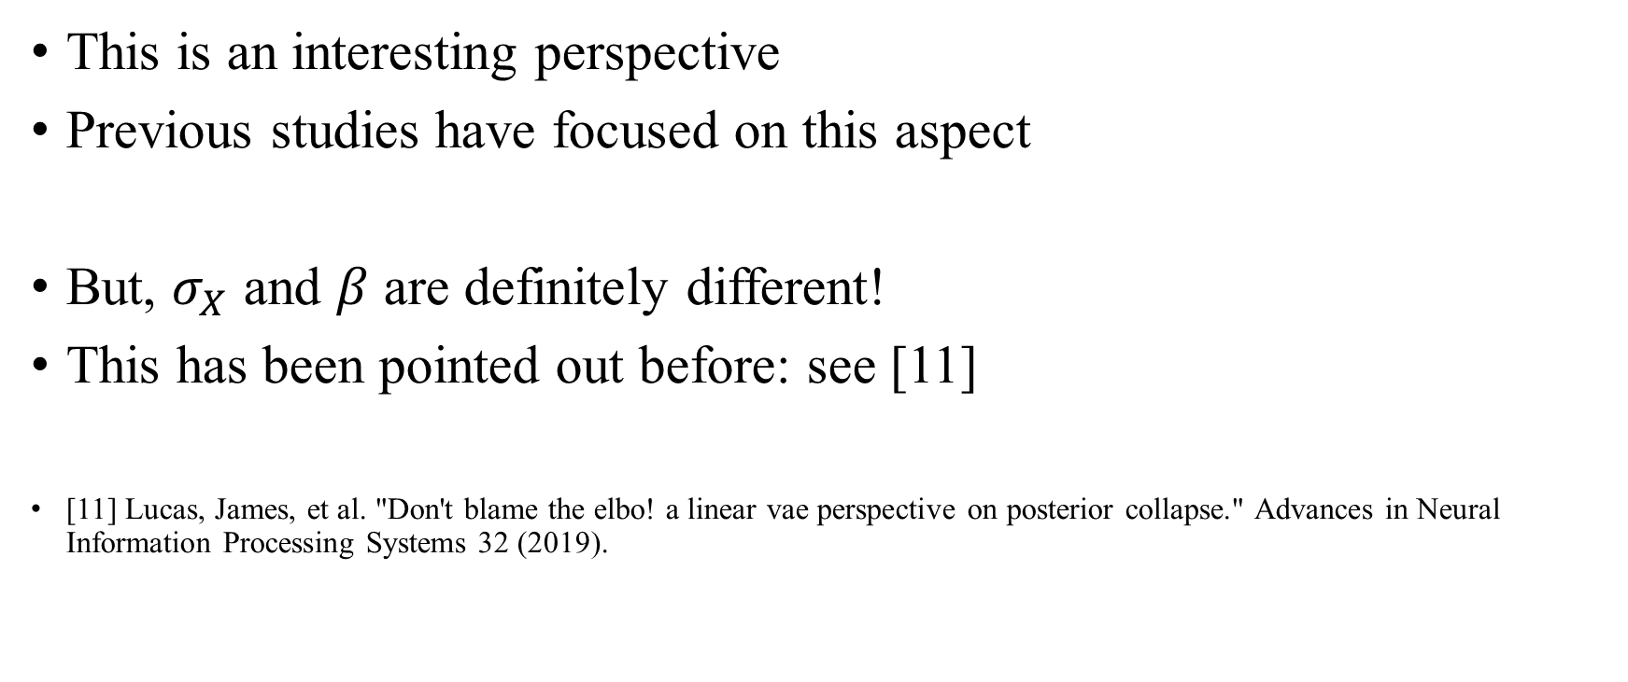
Connection between sigma and beta (contd.)
This is an interesting perspective
Previous studies have focused on this aspect
But, $σ_{X}$ and $β$ are definitely different!
This has been pointed out before: see [11]
[11] Lucas, James, et al. "Don't blame the elbo! a linear vae perspective on posterior collapse." Advances in Neural Information Processing Systems 32 (2019).

Slide 15
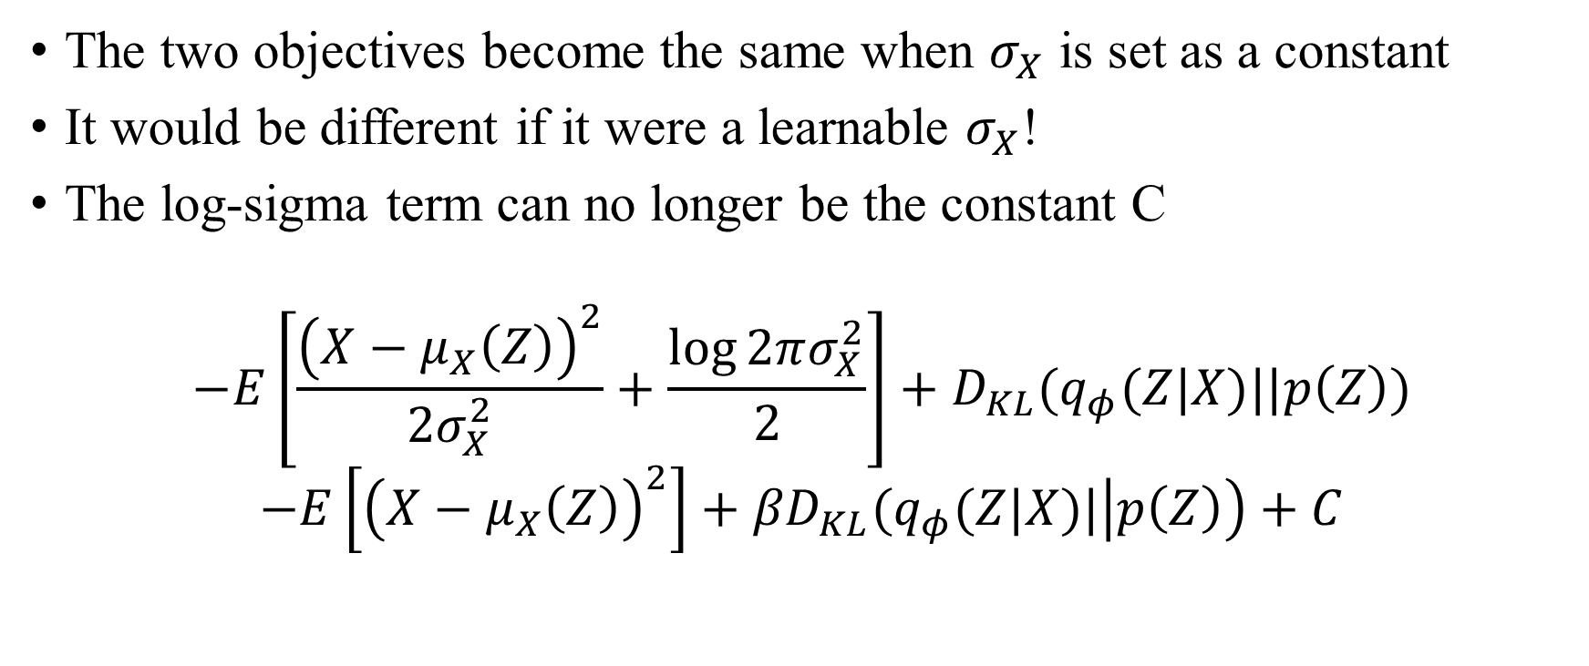
Learnable sigma
The two objectives become the same when $σ_{X}$ is set as a constant
It would be different if it were a learnable $σ_{X}$!
The log-sigma term can no longer be the constant C
$$−E\left[\frac{{\left(X−μ_{X}\left(Z\right)\right)}^{2}}{{2σ}_{X}^{2}}+\frac{\log{2πσ_{X}^{2}}}{2}\right]+D_{KL}(q_{φ}(Z|X)||p\left(Z\right))$$
$$−E\left[{\left(X−μ_{X}\left(Z\right)\right)}^{2}\right]+{βD}_{KL}(q_{φ}(Z|X)|\left|p\left(Z\right)\right)+C$$

Slide 16

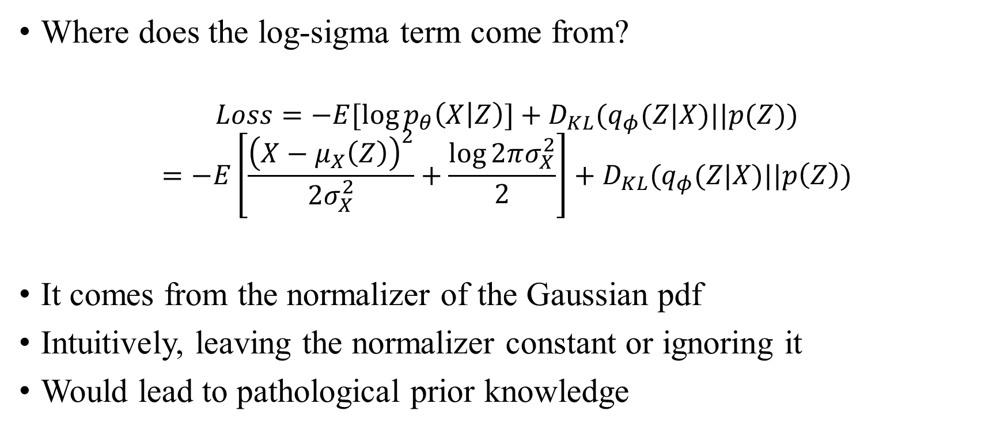
Learnable sigma (contd.)
Where does the log-sigma term come from?
$$Loss=−E[\log{p_{θ}\left(X | Z\right)}]+D_{KL}(q_{φ}(Z|X)||p(Z))$$
$$=−E\left[\frac{{\left(X−μ_{X}\left(Z\right)\right)}^{2}}{{2σ}_{X}^{2}}+\frac{\log{2πσ_{X}^{2}}}{2}\right]+D_{KL}(q_{φ}(Z|X)||p\left(Z\right))$$
It comes from the normalizer of the Gaussian pdf
Intuitively, leaving the normalizer constant or ignoring it
Would lead to pathological prior knowledge

Slide 17
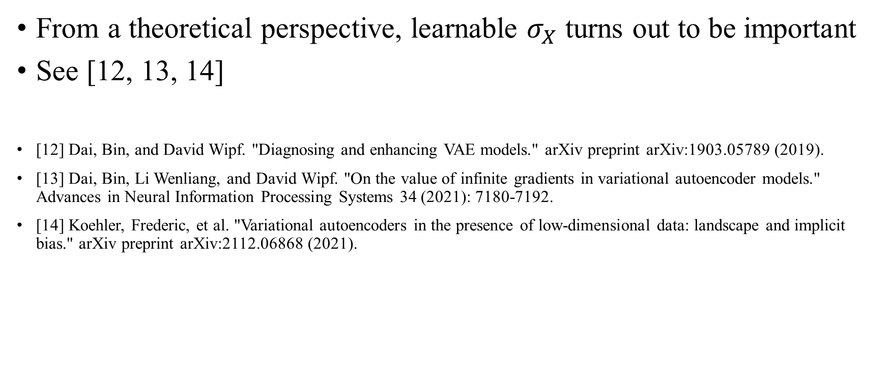
Learnable sigma is integral
From a theoretical perspective, learnable $σ_{X}$ turns out to be important
See [12, 13, 14]
[12] Dai, Bin, and David Wipf. "Diagnosing and enhancing VAE models." arXiv preprint arXiv:1903.05789 (2019).
[13] Dai, Bin, Li Wenliang, and David Wipf. "On the value of infinite gradients in variational autoencoder models." Advances in Neural Information Processing Systems 34 (2021): 7180-7192.
[14] Koehler, Frederic, et al. "Variational autoencoders in the presence of low-dimensional data: landscape and implicit bias." arXiv preprint arXiv:2112.06868 (2021).

Slide 18
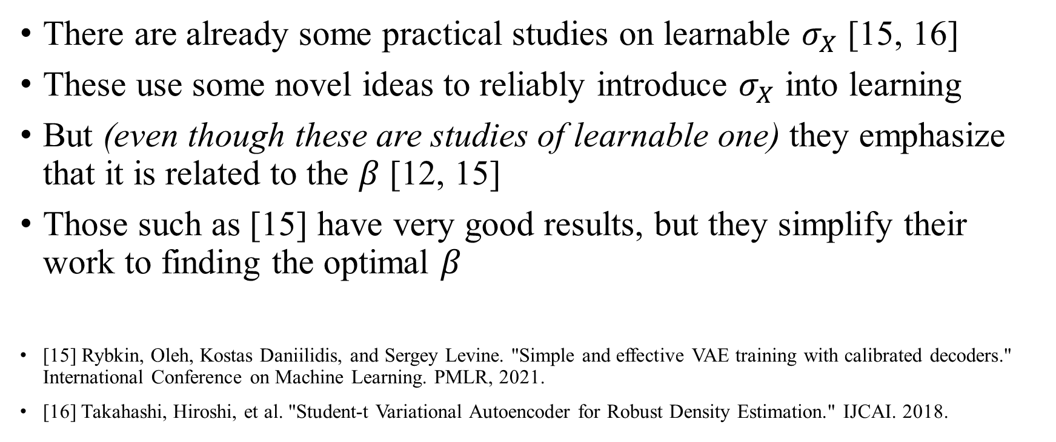
Implementation of Learnable sigma
There are already some practical studies on learnable $σ_{X}$ [15, 16]
These use some novel ideas to reliably introduce $σ_{X}$ into learning
But (even though these are studies of learnable one) they emphasize that it is related to the $β$ [12, 15]
Those such as [15] have very good results, but they simplify their work to finding the optimal $β$
[15] Rybkin, Oleh, Kostas Daniilidis, and Sergey Levine. "Simple and effective VAE training with calibrated decoders." International Conference on Machine Learning. PMLR, 2021.
[16] Takahashi, Hiroshi, et al. "Student-t Variational Autoencoder for Robust Density Estimation." IJCAI. 2018.

Slide 19
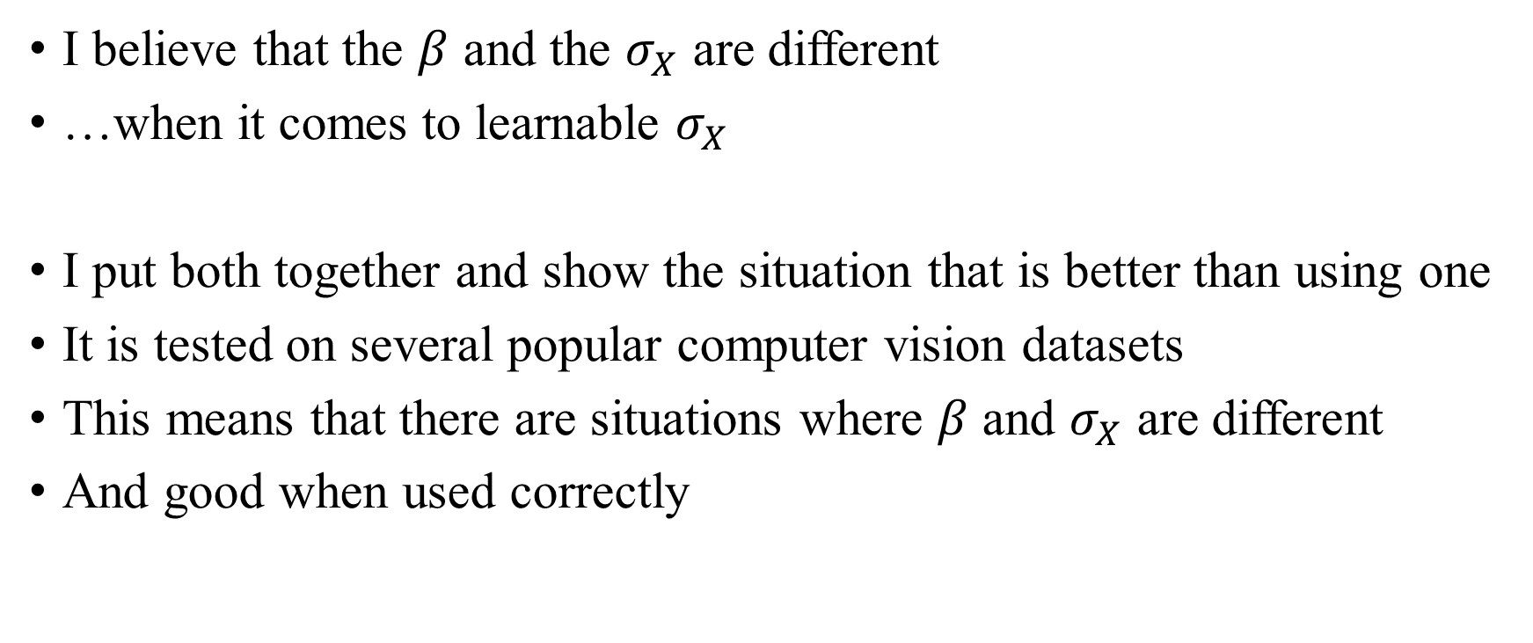
Isolating beta from sigma
I believe that the $β$ and the $σ_{X}$ are different
…when it comes to learnable $σ_{X}$
I put both together and show the situation that is better than using one
It is tested on several popular computer vision datasets
This means that there are situations where $β$ and $σ_{X}$ are different
And good when used correctly

Slide 20
Experiment

Slide 21
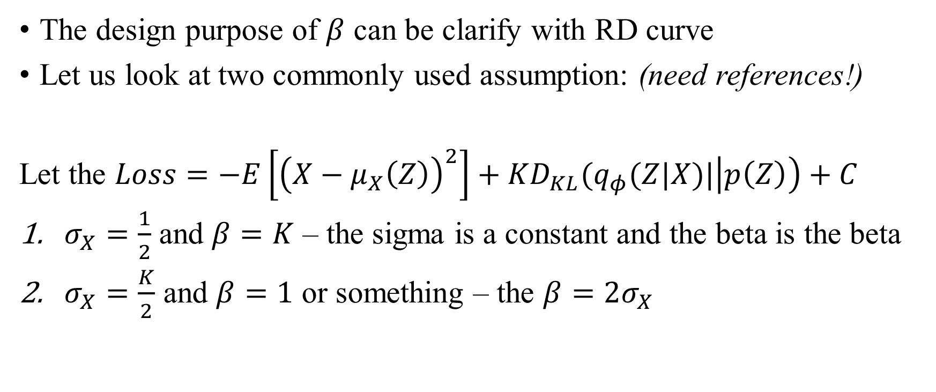
Experiment 1. Rate-Distortion Curve
The design purpose of $β$ can be clarify with RD curve
Let us look at two commonly used assumption: (need references!)
Let the $Loss=−E\left[{\left(X−μ_{X}\left(Z\right)\right)}^{2}\right]+{KD}_{KL}(q_{φ}(Z|X)|\left|p\left(Z\right)\right)+C$
$σ_{X}=\frac{1}{2}$ and $β=K$ – the sigma is a constant and the beta is the beta
$σ_{X}=\frac{K}{2}$ and $β=1$ or something – the $β=2σ_{X}$

Slide 22
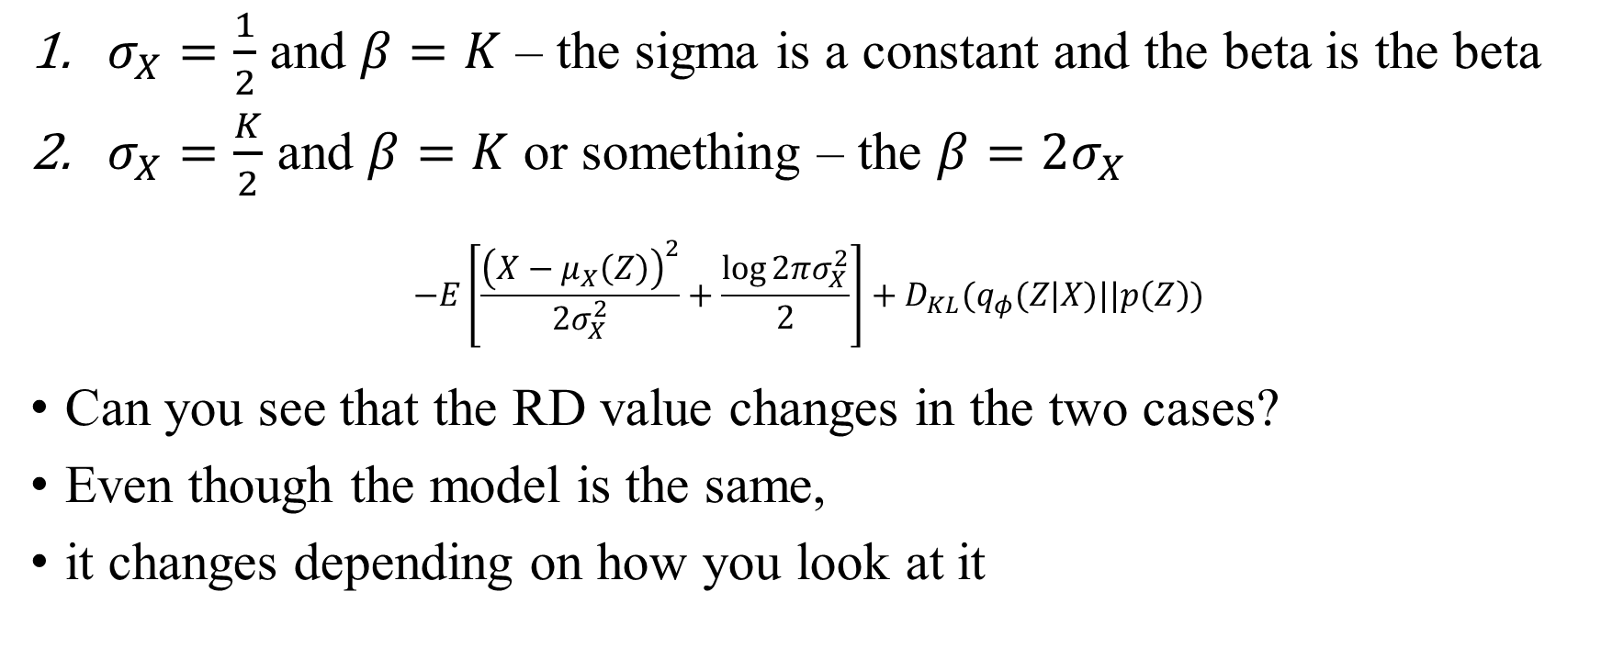
Experiment 1. Rate-Distortion Curve (contd.)
$σ_{X}=\frac{1}{2}$ and $β=K$ – the sigma is a constant and the beta is the beta
$σ_{X}=\frac{K}{2}$ and $β=K$ or something – the $β=2σ_{X}$
$$−E\left[\frac{{\left(X−μ_{X}\left(Z\right)\right)}^{2}}{{2σ}_{X}^{2}}+\frac{\log{2πσ_{X}^{2}}}{2}\right]+D_{KL}(q_{φ}(Z|X)||p\left(Z\right))$$
Can you see that the RD value changes in the two cases?
Even though the model is the same,
it changes depending on how you look at it

Slide 23
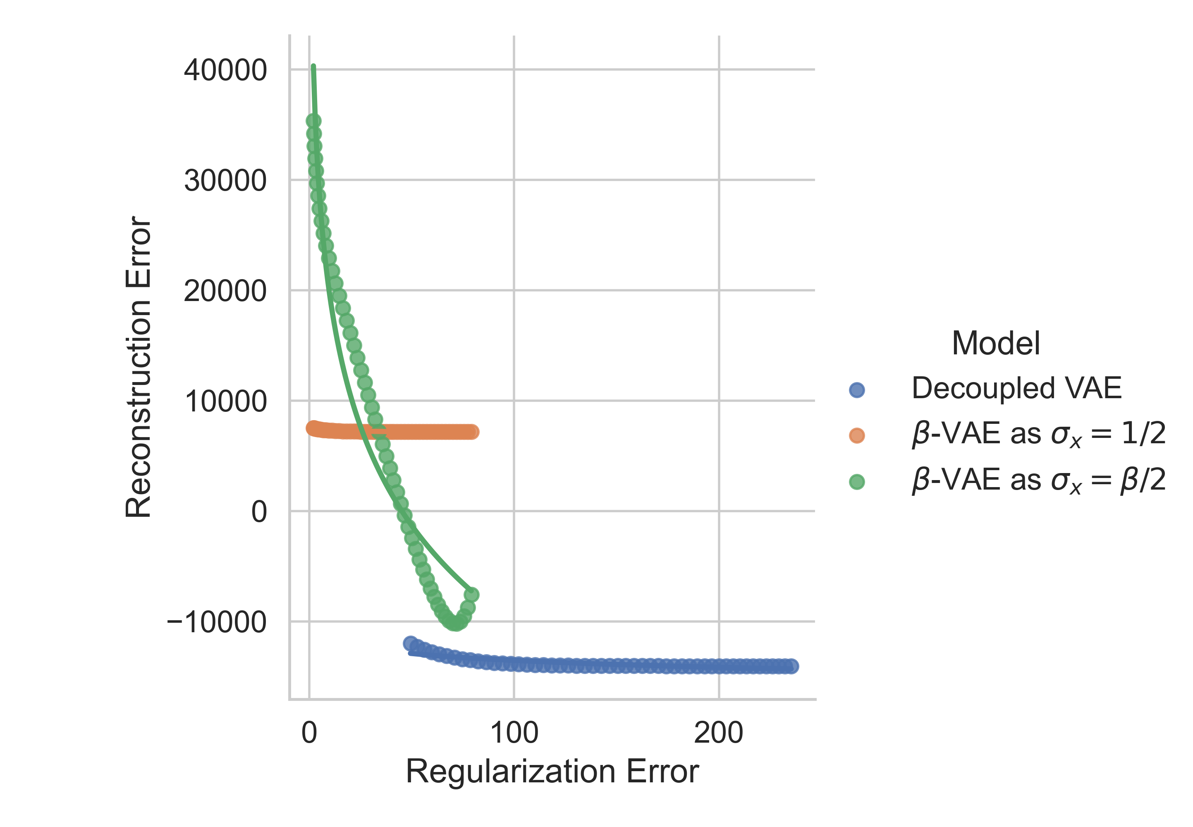

Experiment 1. Rate-Distortion Curve (contd.)
I plan to show that applying $β$ and $σ_{X}$ separately (decoupled one) is better in terms of RD than in both of previous cases
This is the result of a rough experiment
Anyway, it is further down
= It performs better

Slide 24
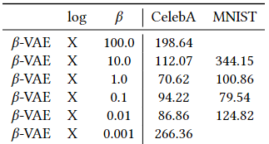
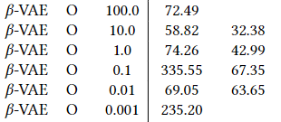
Experiment 2. Proxy Metric
In the end, the evaluation of the generative model is based on metrics
I will show that the best decoupled model is better than the best baseline models through proxy metrics e.g. FID score
Lower is better
Remarkable difference…

Slide 25
Thank you
This is (probably) the final refined version of an argument
… which I have been making for months
I am planning to write a paper based on this development
And always thirsty for better mathematical proofs or ingenious experiments
If you have any idea, please discuss it any time
Any question?

Slide 26
References
[1] Kingma, Diederik P., and Max Welling. "Auto-encoding variational bayes." arXiv preprint arXiv:1312.6114 (2013).
[2] Bowman, Samuel R., et al. "Generating sentences from a continuous space." arXiv preprint arXiv:1511.06349 (2015).
[3] Ballé, Johannes, et al. "Variational image compression with a scale hyperprior." arXiv preprint arXiv:1802.01436 (2018).
[4] An, Jinwon, and Sungzoon Cho. "Variational autoencoder based anomaly detection using reconstruction probability." Special lecture on IE 2.1 (2015): 1-18.
[5] Jin, Wengong, Regina Barzilay, and Tommi Jaakkola. "Junction tree variational autoencoder for molecular graph generation." International conference on machine learning. PMLR, 2018.
[6] Lucas, James, et al. "Understanding posterior collapse in generative latent variable models." (2019).
[7] Higgins, Irina, et al. "beta-vae: Learning basic visual concepts with a constrained variational framework." International conference on learning representations. 2016.
[8] Alemi, Alexander, et al. "Fixing a broken ELBO." International conference on machine learning. PMLR, 2018.
[9] Burgess, Christopher P., et al. "Understanding disentangling in $\beta $-VAE." arXiv preprint arXiv:1804.03599 (2018).
[10] Kumar, Abhishek, and Ben Poole. "On Implicit Regularization in $ β $-VAEs." International Conference on Machine Learning. PMLR, 2020.
[11] Lucas, James, et al. "Don't blame the elbo! a linear vae perspective on posterior collapse." Advances in Neural Information Processing Systems 32 (2019).
[12] Dai, Bin, and David Wipf. "Diagnosing and enhancing VAE models." arXiv preprint arXiv:1903.05789 (2019).
[13] Dai, Bin, Li Wenliang, and David Wipf. "On the value of infinite gradients in variational autoencoder models." Advances in Neural Information Processing Systems 34 (2021): 7180-7192.
[14] Koehler, Frederic, et al. "Variational autoencoders in the presence of low-dimensional data: landscape and implicit bias." arXiv preprint arXiv:2112.06868 (2021).
[15] Rybkin, Oleh, Kostas Daniilidis, and Sergey Levine. "Simple and effective VAE training with calibrated decoders." International Conference on Machine Learning. PMLR, 2021.
[16] Takahashi, Hiroshi, et al. "Student-t Variational Autoencoder for Robust Density Estimation." IJCAI. 2018.

Slide 27
Thank you for listening
Presenter: Kim Seung Hwan (overnap@khu.ac.kr)

